Slide 1

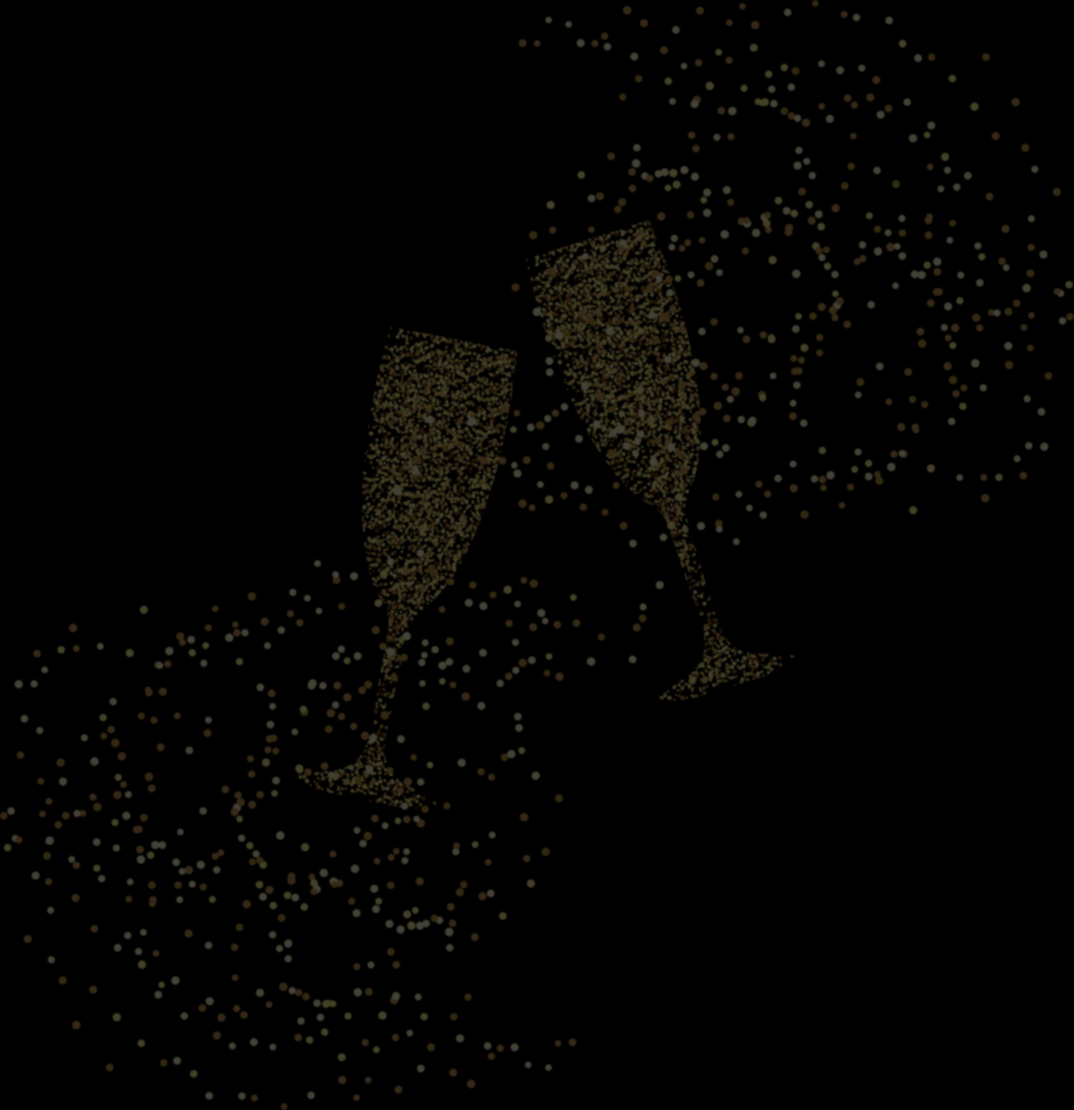


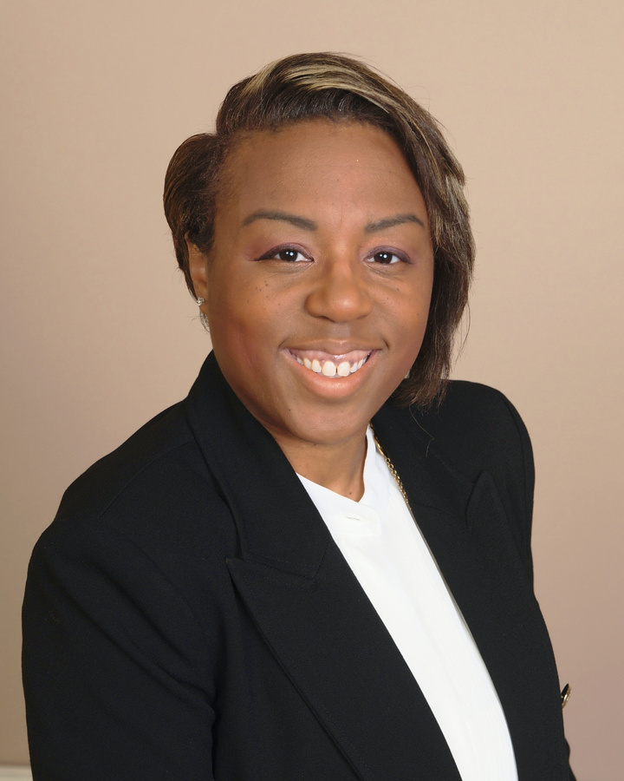
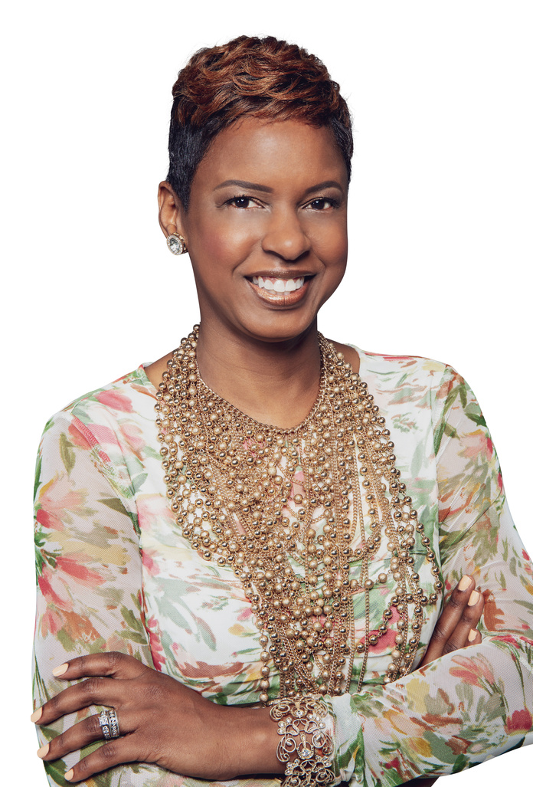
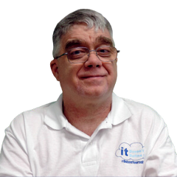
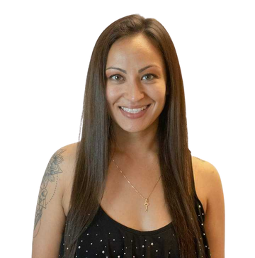
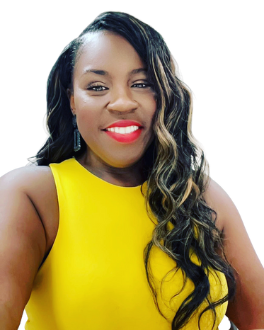
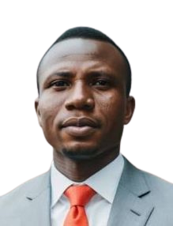
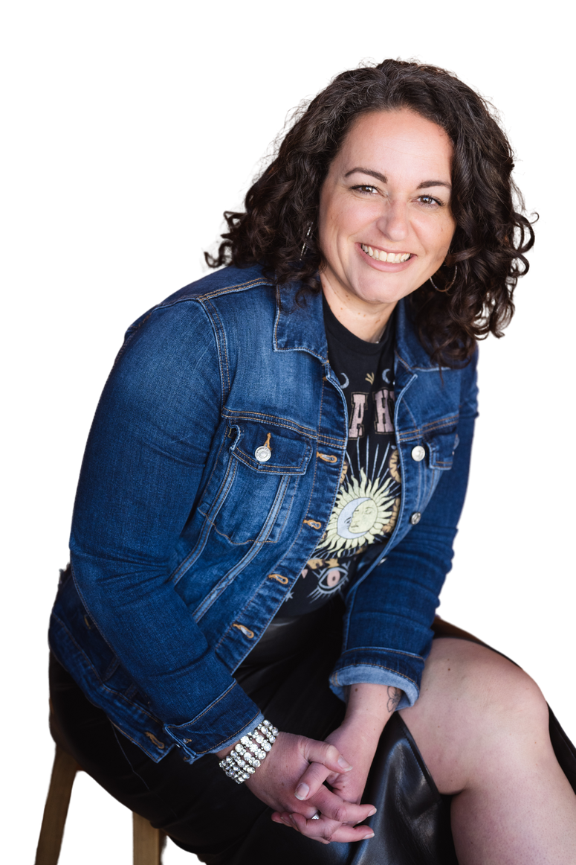
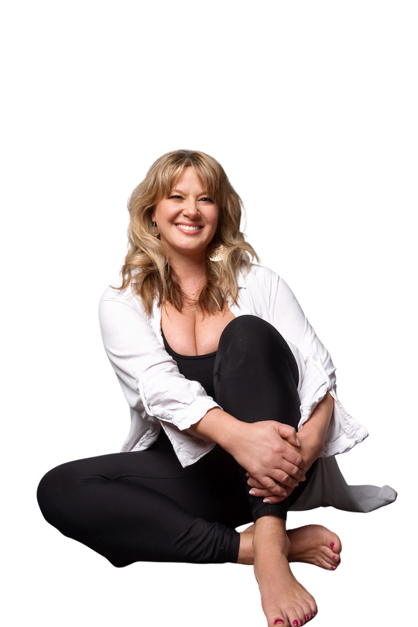
January 1, 2024 | 2:30 PM EST
2024
Create a vision for your best year yet!
Career & Mindset Transformation
Hosted by:
Dr. Kristy K. Taylor
VISION BOARD PARTY!
Certified Career and Master Mindset Life Coach, Founder of WORxK Solutions, LLC.
MEET OUR SPEAKERS:
Kristie Kennedy
Chris Mitchell
Sonda Eunus
Latonyia Sumpter
Olusegun Eluyode
Candace Lance
Katie Kozlowski
TEDx Audacious Leadership Keynote Speaker and Authentic Lifestyle Author
Founder/CEO of #DefineYourself
CEO, Leading
Marketing Solutions
Founder, Empowered
Well-being LLC
Founder of Housterdin Consulting and Lacaperia Academy
Founder of Holistically Well & Certified Holistic Wellness Coach
Master Energy and Embodiment Coach and the Creator of the ShaktiBomb Method™️

Slide 2


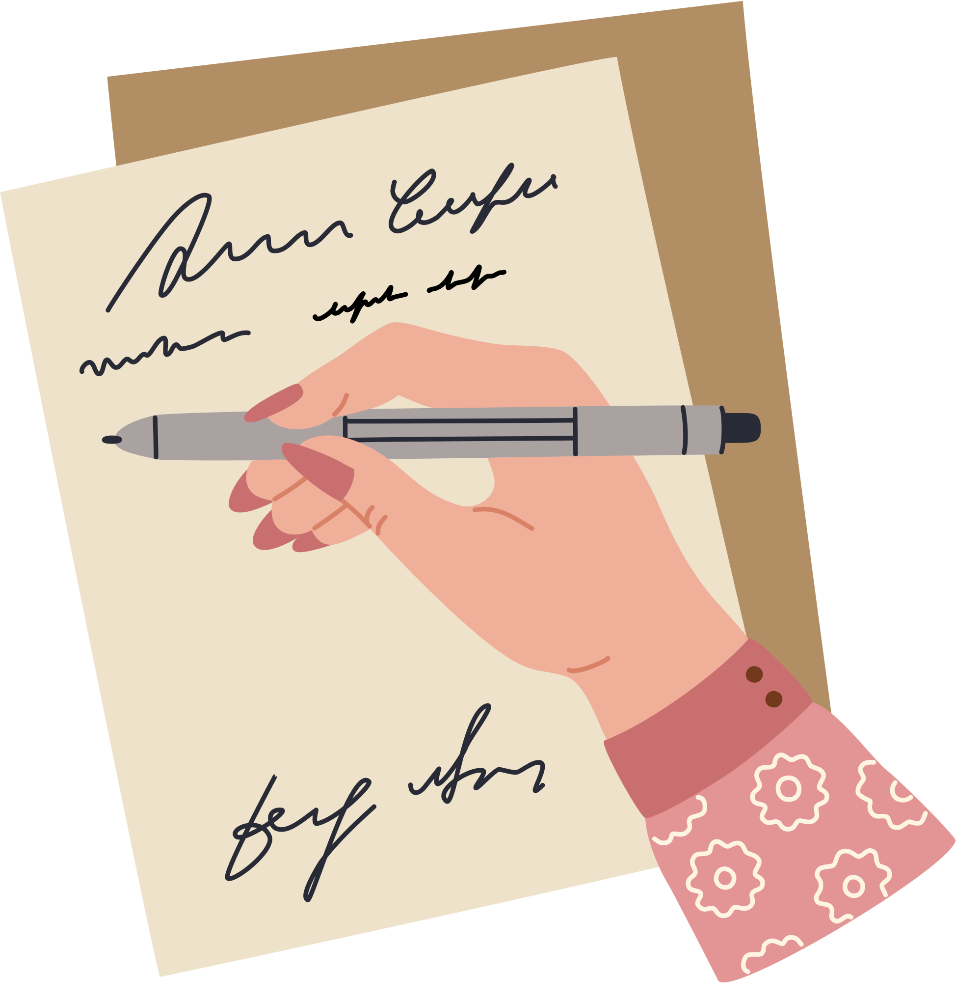
2024
MY VISION
What are some key career goals or aspirations you hope to achieve by the end of 2024?
What symbols or images represent the skills, values, and aspirations you want to embody in your professional life in 2024?
What positive mindset or attitude do you believe is crucial for achieving your career goals in 2024?
If your career were a story, what would be the key chapters or highlights you'd want to include in the narrative of 2024?

Slide 3




WHAT CAN I SAY TO MYSELF?
Instead of saying this...
Try....
"I'm not good enough."
"I am capable and continually improving."
"I'll never succeed."
"I am on a path to success, and each step forward is a victory."
"I always mess things up."
"I learn from my mistakes and use them as opportunities for growth."
"I'm a failure."
"I am resilient, and setbacks don't define my worth."
"I'm not smart/talented/attractive enough."
"I possess unique strengths and qualities that make me valuable."
"I'll never be as good as [someone else]."
"I celebrate my unique qualities and recognize my own worth."
"I'm too [old, young, inexperienced, etc.]."
"My age and experiences contribute to my wisdom and growth."

Slide 4


CRAFTING MY VISION BOARD
  Find Inspirational Images: Go to Google Images or any preferred image search engine.
  Search and Save:
    Find images that represent your goals.
    Right-click on the images, choose "Save Image As..." and save them to your computer.
  Insert Images into PowerPoint:
    Head on the next slide.
    Click on the white area; it's your vision board.
    Navigate to "Insert," choose "Pictures," and add the saved images.
  Resize and Arrange:
    Resize images to fit the white space.
    Arrange them visually.
  Customize and Decorate:
    Use PowerPoint features for colors, shapes, and fonts to customize.
    Be creative and make it visually inspiring!
  Save Your Vision Board:
    Save this PowerPoint file by clicking “Ctrl + S”
  Reflect:
    Take a moment to reflect on your vision board.
  Set as Desktop Background (Optional):
    Save the slide as an image and set it as your desktop background for a constant reminder.
  Stay Inspired:
    Regularly revisit your vision board to stay motivated and focused on your goals.

Slide 5
MY VISION BOARD

Slide 6


Set a positive career mindset affirmation you can say to yourself in 2024.

Slide 7
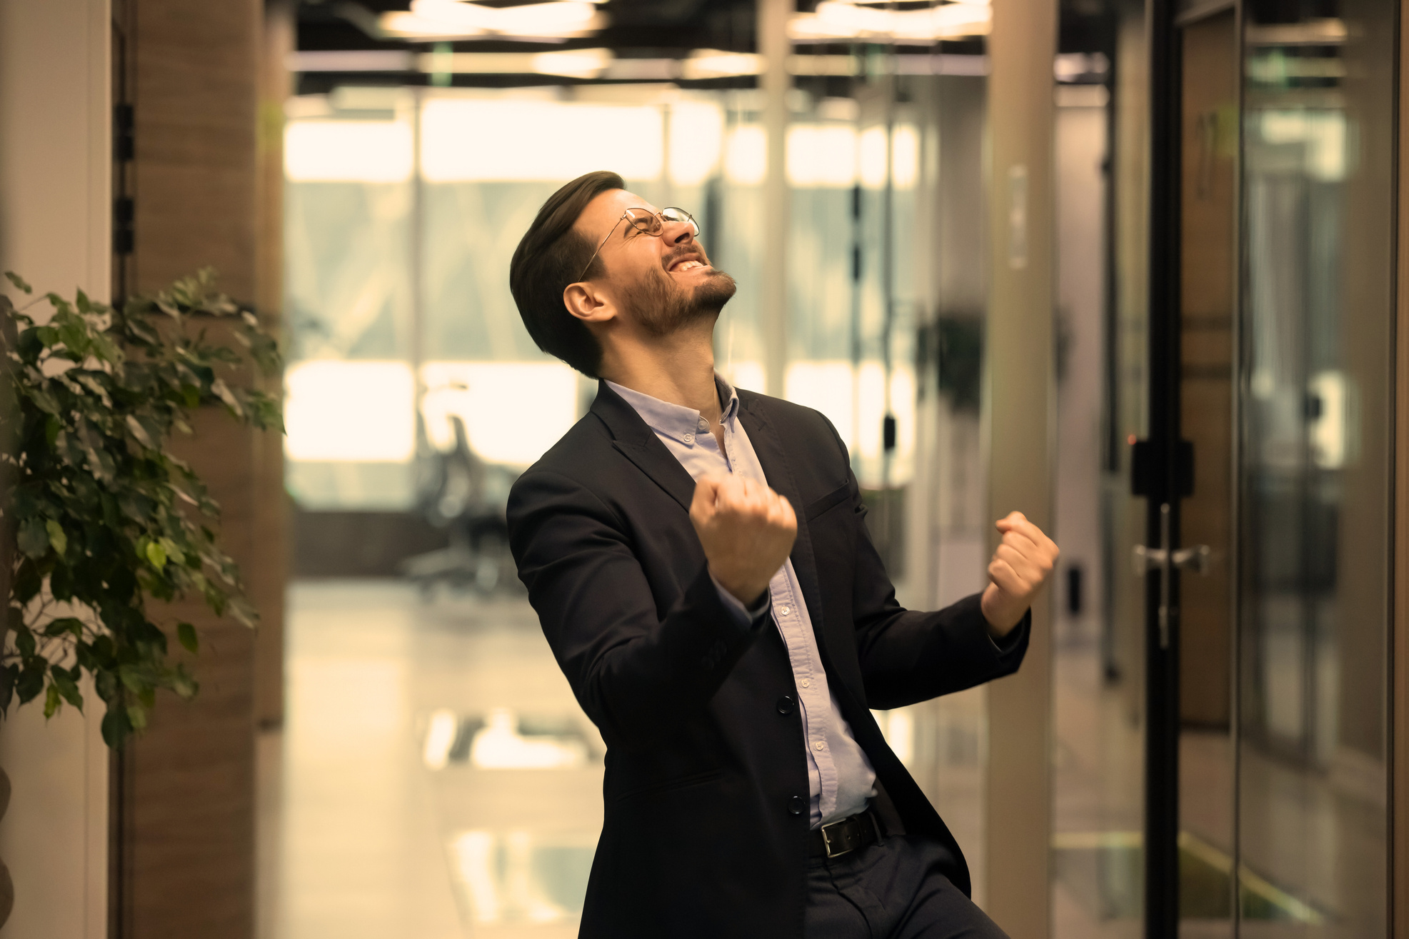








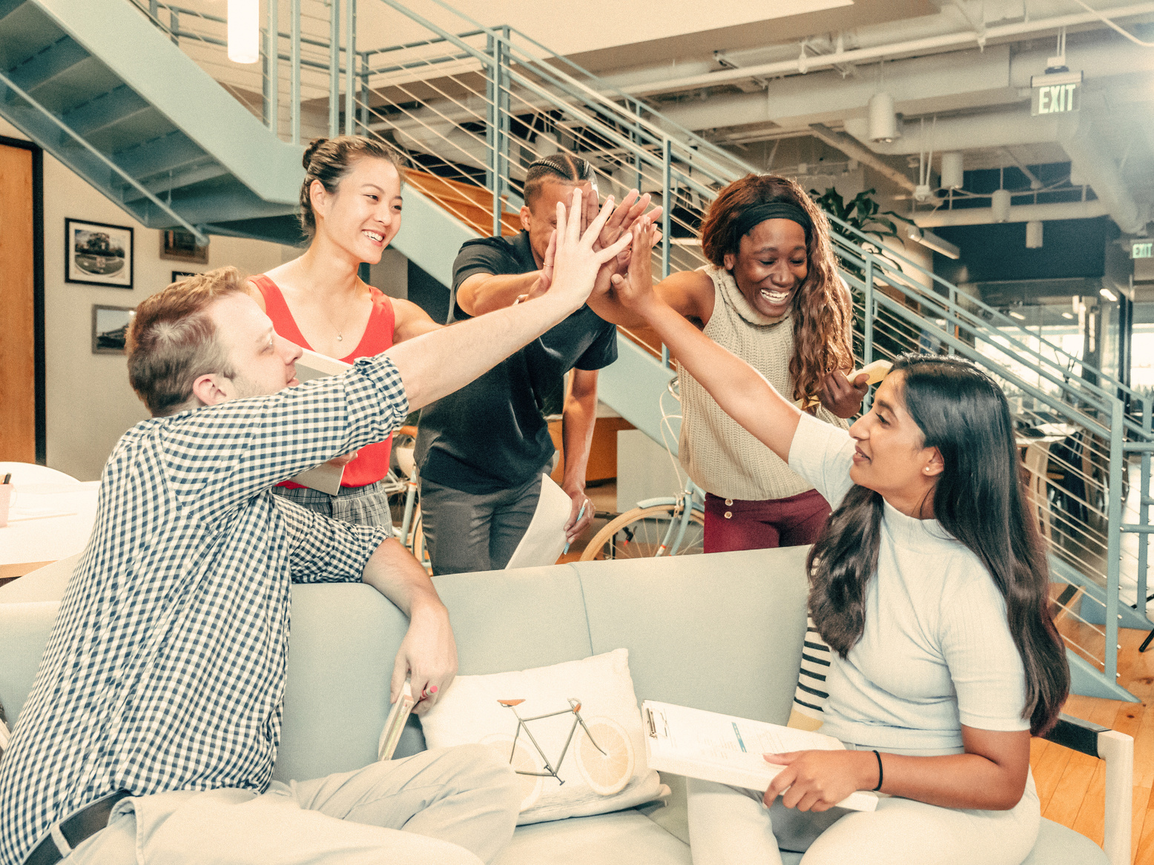
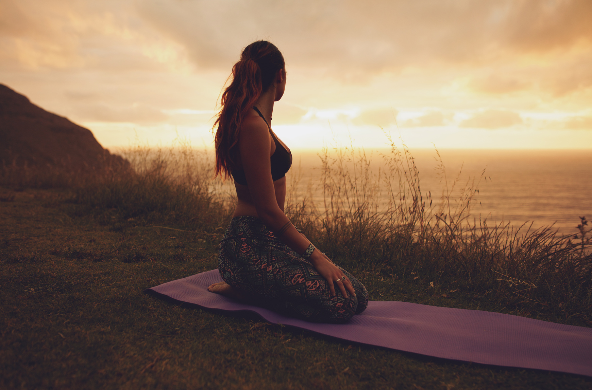

2024
VISION BOARD
PARTY
Create a vision for your best year yet!
Dr. Kristy K. Taylor
Live Host

Slide 8
MEET OUR SPEAKERS
Kristie Kennedy, The Image Confidence Expert is a TEDx Audacious Leadership Keynote Speaker and Authentic Lifestyle Author. As the owner of Queenfidence ®Global Image Consulting her electrifying inspirational gift empowers visionaries with confidence and clarity keys to find their voice, free their voice and look fabulous using their voice. She specializes in four areas of peak performance: mindset mastery, massive momentum, magnetic messaging and potential maximization. She is a Certified Radical Resilience Coach who builds powerhouse mindsets, equipped for success. Kristie's evocative teaching style elevates your self-perception from stuck to unstoppable, invisible to invincible and timid to tenacious. Her bodacious belief is a testament that you can shift from mediocrity to magnificence one daring action step at a time.
Connect with Kristie
Facebook: kristieykennedy
Instagram: kristieykennedy
LinkedIn: kristieykennedy
Twitter: kristieykennedy
Youtube: @queenfidence
Chris Mitchell is a 2-time award-winning speaker and a certified confidence life coach who serves the disabled community. Chris is the author of the soon-to-be-released book, “Success Starts with Self-Confidence” and the host of the “Successful, Self-Employed & Disabled Podcast” debuting January 2024.
Connect with Chris
Facebook: TheChrisMitchellOfficial
Instagram: thechrismitchellofficial
LinkedIn: thechrismitchellofficial
Youtube: @TheChrisMitchellOfficial
Website: https://thechrismitchell.com/
Sonda Eunus, Owner of LMS Plus, a Marketing & Events company, and LMS Network, a free Business Networking group, organizes frequent networking and educational events. LMS also hosts vendor expos, charity drives, and more. Sonda's true passion lies in dance, and she recently launched DanceFit Wellness, offering over 30 weekly group classes in dance, fitness, self-defense, martial arts, music, nutrition, stress relief, yoga, and more for $75/month. Kids can join for free. The center also provides medical and mental health care, holistic therapies, private training, healthy eating options, and more at www.dancefit-pro.com.
Connect with Sonda
Website: www.dancefit-pro.com
Latonyia Sumpter is the founder of Empowered WellBeing, a 300-hour certified yoga instructor, and Women’s Empowerment Coach. She is a beacon of strength and resilience on a mission to empower women through holistic wellness. Her journey began against a backdrop of childhood abandonment, rejection, and molestation experiences that could have defined her, but instead, fueled her determination to overcome. Her mission is now to help other women across the globe grow, heal, and flourish through transformative practices both on and off the yoga mat.
Connect with Latonyia
Instagram: Empowered_wellbeing1
Tiktok: Empowered Wellbeing

Slide 9
MEET OUR SPEAKERS
Olusegun Eluyode, also known as Phenomenal Trainer, is a career advisor, author, business strategist, serial entrepreneur, and anti-status quo advocate. He is the founder of Housterdin Consulting and Lacaperia Academy. Olusegun is the author of several works, including "Create Your Throne in That Industry," "African Youth," and "The Future of Jobs," among others.
Connect with Olusegun
Facebook: seguneluyode
Instagram: oluseguneluyode_TPT
LinkedIn: oluseguneluyode
Candace Lance is a certified Ayurveda Nutritionist & Certified Holistic Wellness Coach. She transitioned from corporate burnout and hitting rock bottom in her health to become the founder of Holistically Well, a wellness practice rooted in optimal health, well-being, and longevity through Ayurveda practices.
Connect with Candace
Facebook: holisticallywellwithcandace
Instagram: holisticallywellwithcandace
Website: http://www.holisticallywellut.com/
Free Resource, Build a Routine to Meet Your Needs: https://view.flodesk.com/pages/64e14c07c7567cef7b9f6be5
Complementary 30 minute health & wellness coaching session:
https://heal.me/practitioner/candace-n-lance
Katie Kozlowski is a master energy and embodiment coach and the creator of the ShaktiBomb Method™️. She assists smart, spiritually driven, and highly motivated individuals in making significant breakthroughs, empowering them to manifest more of what they desire by connecting to their core beliefs, needs, and desires.
Connect with Katie
Facebook: katie.kozlowski
Instagram: iamkatiekozlowski
Website: http://www.katiekozlowski.com/

Slide 10
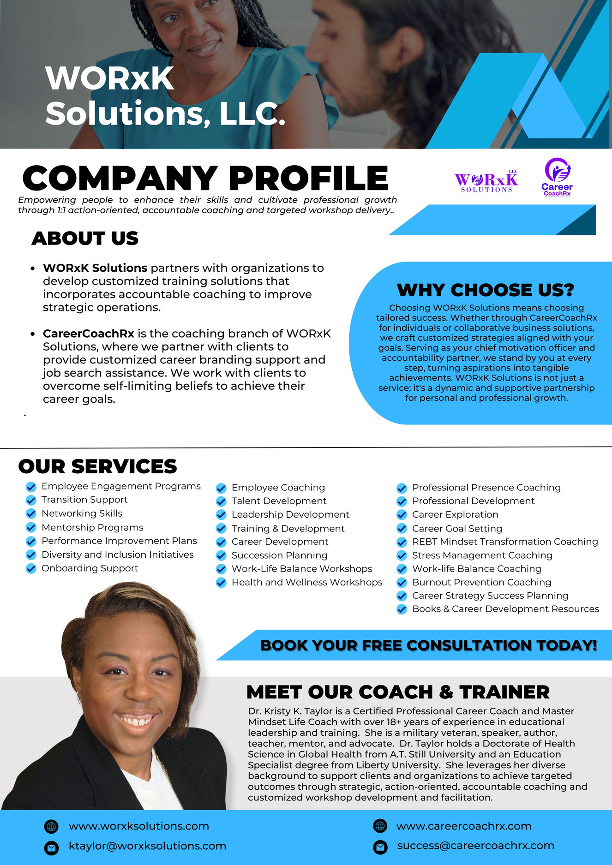








For Personal Career Coaching and Career Branding Services
For Businesses and Organizations
Follow us on all our social media accounts

Slide 11
January 1, 2024 | 2:30 PM EST
2024
Create a vision for your best year yet!
Career & Mindset Transformation
Hosted by:
Dr. Kristy K. Taylor
VISION BOARD PARTY!
Certified Career and Master Mindset Life Coach, Founder of WORxK Solutions, LLC.
MEET OUR SPEAKERS:
Kristie Kennedy
Chris Mitchell
Sonda Eunus
Latonyia Sumpter
Olusegun Eluyode
Candace Lance
Katie Kozlowski
TEDx Audacious Leadership Keynote Speaker and Authentic Lifestyle Author
Founder/CEO of #DefineYourself
CEO, Leading
Marketing Solutions
Founder, Empowered
Well-being LLC
Founder of Housterdin Consulting and Lacaperia Academy
Founder of Holistically Well & Certified Holistic Wellness Coach
Master Energy and Embodiment Coach and the Creator of the ShaktiBomb Method™️

